Slide 1


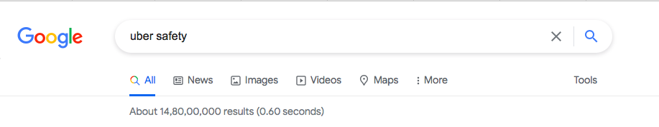
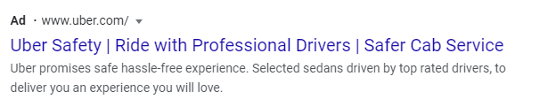
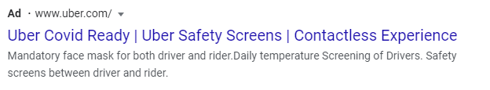
Uber’s Digital Marketing Strategy
Marketing Objective: Action
Group 3
A047 – Smridhi Arya
G017 – Khyati Mehta
I001 – Rudrapriya Bose
I017 – Dushyant Sharma
I024 – Guneet Singh
I041 – Shubhankar Singha

Slide 2
OBJECTIVE
Boost revenue for Q3 2021 by 5% with respect to expected revenue following current growth trends
Recovery stage (post lifting of lockdown restrictions)
INSIGHT
Lower trips count
Longer average trip distance
PAST OBSERVATIONS
INSIGHT
Higher trips count
Short to medium average trip distance
Post recovery stage
Focus on growth of trip count as it has a better correlation with revenue growth
Focus on frequent travellers
Emphasis on Covid safety protocols, incentivize frequent travellers
EXPECTATION
Q3 2021 - Falls under post recovery stage
DIRECTION

Slide 3
Coupon code - CovidReady
Eligibility - Identified customers with frequent travel history with Uber/frequent travel requirements
Measurement - 1. Identify target audience
2. Introduce coupon code through various channels
3. Measure contribution to revenue (for Q3 only)
i) track bookings that are using the coupon code
ii) Actual Revenue (from the target audience using the coupon code)
iii) Expected revenue (from the target audience in the absence of the campaign)
iv) Marketing spend
v) Actual Revenue - Expected Revenue - Marketing spend = Revenue Contribution
vi) Revenue Contribution/ Expected total revenue * 100

Slide 4
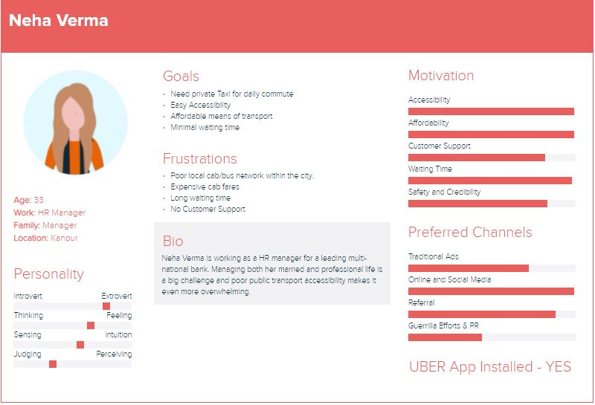
Buyer Personas

Slide 5
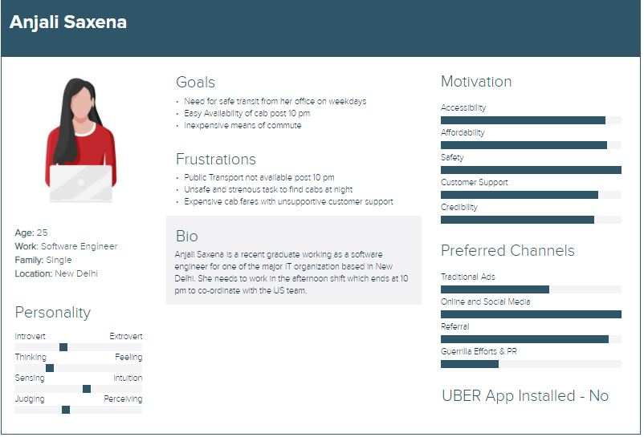

Slide 6
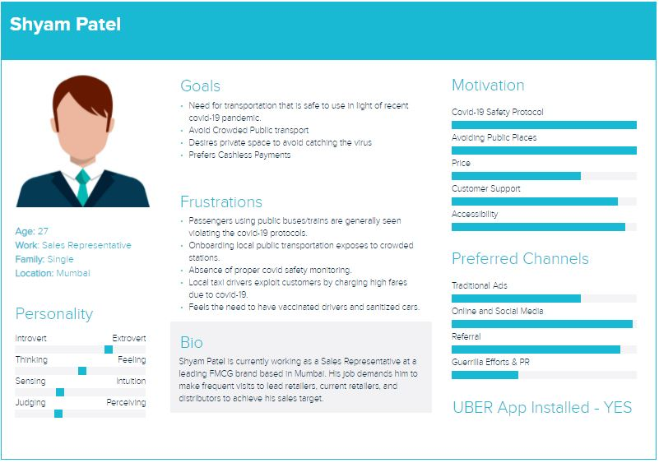

Slide 7
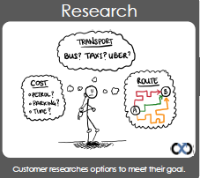
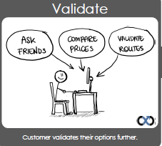
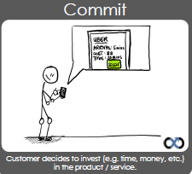
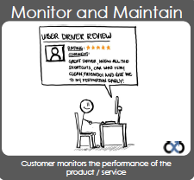
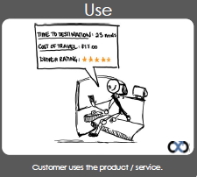
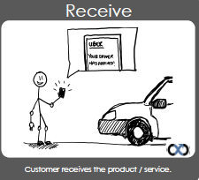
Start Here
Keep looking for options
Uber didn’t give me the info I need
Need to continue validate using Uber
Uber does not meet my needs
Poor experience, need to change requirement
Signing up & using was a poor experience
“Do I need to confirm my research about Uber?”
Uber sounds good, but need to validate
Uber meets my demands, lets give it a try.
Do I want to continue using it?
Is Uber Right for me?
Uber Customer Journey
No need to validate, ready to use Uber
Keen to continue using Uber
That was a good experience. Ready to use it gaian
It did. I am going to check my rating,
Did the trip meet my expectations
Let’s see how the journey goes
Did the driver meet my expectations
Will I use Uber again?
End to end experience was poor.
The travel experience was poor
Waiting for the service & then receiving was poor

Slide 8
1
2
3
I need to research transport options
I need a quick, safe & cost effective transport
I want to contact someone from Uber
Success Criteria
Success Criteria
Success Criteria
Transport must be available when I need
Must have
Transport must take an efficient route possible
Must have
Able to interact with Uber to get information quickly
Must have
It should be apt for me & my friends
Must have
I need to get to my destination in a set amount of time
Must have
Able to access knowledge base before I contact someone.
Must have
It should be safe
Must have
It must cost less than driving my own car
Could have
Want different option (eg: cheap/luxury)
Could have
Customer Objectives
4
5
6
I want to check reviews on social media
I want to easily set my travel criteria
I want to easily finalize my booking
Success Criteria
Success Criteria
Success Criteria
Able to get information on Uber from other users.
Must have
Ability to set my pickup location
Must have
Ability to select payment method
Must have
Able to get information on Uber drivers
Must have
Ability to select my destination
Must have
Receive confirmation of my selection
Must have
Ability to select the type of transportation (small vehicle)
Could have
Receive notification on expected driver arrival time
Must have
Ability to specify condition for my route (avoid tolls).
Could have
Provide me an estimated travel time
Could have

Slide 9
7
8
9
I want to know the status of my driver
I want to have a positive engagement with my driver
I want to know if I am getting value for money
Success Criteria
Success Criteria
Success Criteria
Be able to track the location of my driver
Must have
The driver is polite
Must have
The route taken will get me there on time
Must have
Receive notification if my driver is close
Must have
The driver assisted me if I had heavy luggage
Must have
The route taken is most cost efficient
Must have
Expect that my driver arrives on time
Must have
Driver informs me of any changes to my travel (eg: fare)
Must have
The journey got me there earlier
Could have
Want to be notified when my driver has arrived
Could have
The fare was cheaper than the estimate
Could have
Customer Objectives
10
11
I want to provide feedback on my experience
I want to manage my account
Success Criteria
Success Criteria
Able to provide feedback on the driver
Must have
Able to view all the trips I have taken
Must have
Able to provide feedback on the car quality
Must have
Able to see all the payment transactions
Must have
Able to provide feedback on the fare
Must have
Able to change my details (contact or payment details)
Must have
Able to provide feedback on the route taken
Must have
Able to print travel logs (for business expenses)
Could have

Slide 10
1
2
3
Mobile Application
Mobile Application
Mobile Application
Criteria Met
Criteria Met
Criteria Met
Must Have
Must Have
Must Have
100%
Could Have
100%
100%
Could Have
0%
50%
Could Have
N/A
Able to get all information required on transport and options.
Able to see information about safety & driver quality.
Would have been useful if the apps did the comparison between driving and Uber.
Not being able to contact someone (eg: a phone number) was unexpected
The knowledge base was a good resource.
Uber Website
Uber Website
Uber Website
Touchpoint analysis
Criteria Met
Criteria Met
Criteria Met
Must Have
Must Have
Must Have
100%
Could Have
100%
0%
Could Have
0%
50%
Could Have
N/A
Able to get all information required on transport and options.
Able to see information about safety & driver quality.
Was not able to get any of the information I needed as I had to use the mobile app
Not being able to contact someone (eg: a phone number) was unexpected
The knowledge base was a good resource.

Slide 11
4
5
6
Uber Facebook
Mobile Application
Mobile Application
Criteria Met
Criteria Met
Criteria Met
Must Have
Must Have
Must Have
100%
Could Have
N/A
100%
Could Have
50%
100%
Could Have
N/A
There was a collection of feedback from the drivers and users- and uber seems to respond to the positive comments
A major advantage when a pick up location is precisely provided.
Avoiding tolls can’t be done through the app, though can be requested in car
All must have features were readily available for a relatively painless experience.
Uber Website
Uber Website
Touchpoint analysis
Criteria Met
Criteria Met
Must Have
Must Have
0%
Could Have
0%
50%
Could Have
0%
Wasn’t able to book a cab through the website. This was not much of a deterrent as mobile app was available.
Wasn’t able to book a cab through the website. This was not much of a deterrent as mobile app was available

Slide 12
7
8
9
Mobile Application
Uber Driver
Uber Application
Criteria Met
Criteria Met
Criteria Met
Must Have
Must Have
Must Have
100%
Could Have
N/A
100%
Could Have
N/A
100%
Could Have
50%
Able to get information required on transport specs and options.
Able to see information about safety and driver quality.
The driver was polite, helped with the luggage and informed about the traffic conditions.
Route picked was efficient, bypassed a lot of traffic.
The final fare was over the estimated one, but driver explained it thoroughly.
Uber Driver
Touchpoint analysis
Criteria Met
Must Have
100%
Could Have
N/A
Only one criteria was required to be met and it was as the driver arrived on time.

Slide 13
10
11
Mobile Application
Mobile Application
Criteria Met
Criteria Met
Must Have
Must Have
100%
Could Have
N/A
100%
Could Have
0%
Able to provide feedback on the journey, quality of car and driver.
Able to view feedback on myself
Able to view my trips, details of my payment history and the feedback.
Was not able to save data as pdf.
Uber Facebook
Uber Website
Touchpoint analysis
Criteria Met
Criteria Met
Must Have
Must Have
100%
Could Have
N/A
100%
Could Have
100%
Not as structured, but was able to provide feedback on the journey.
Uber also had a chance to respond
Able to view my trips, details of my payment history and the feedback.
Was able to save data as pdf.

Slide 14
1
2
3
4
9
9
9
1
4
4
10
Experience out of 10
Experience out of 10
Experience out of 10
Experience out of 10
Mobile app
Website
Mobile app
Website
Mobile app
Website
Uber Facebook
Comment: Score would be higher if I did not have to click so many times to get the information
Comment: After signing up on the website, instead of a continuous experience, forced me to go to phone
Comment: Not having the ability to contact to someone was disappointing.
Comment: Uber seems to be interacting with their audience at all the social accounts.
Experience Analysis
5
6
7
8
9
1
9
1
10
10
10
Experience out of 10
Experience out of 10
Experience out of 10
Experience out of 10
Mobile app
Website
Mobile app
Website
Mobile app
Uber Driver
Uber Driver
Comment: Score would be higher if I was able to set some conditions (avoid tolls)
Comment: The only reason for not a perfect 10 is paying cash was not an option
Comment: Excellent experience – Notification were great. Good service.
Comment: Driver was polite, even had a charger – Great experience.

Slide 15
9
10
11
10
9
8
9
8
Experience out of 10
Experience out of 10
Experience out of 10
Uber Driver
Mobile app
Uber Facebook
Mobile app
Website
Comment: Great experience with the driver. Fare was more, but it was explained by the driver
Comment: Able to provide feedback on social media, but response may not necessarily come from the driver.
Comment: There was a limitation for the mobile, it would be great if I could save my transactions .
Experience Analysis
Key
Journey of a satisfied Uber user/potential customer
Journey of a dissatisfied Uber user/potential customer.
Experience Analysis Rating
Promoters(NPS 9-10)
Passives (NPS 7-8)
Detractors (0-6)

Slide 16
UBER SEM STRATEGY
OBJECTIVE : Drive Action
MEASUREMENT METRIC : Coupons availed, increase in number of rides, Referrals
Campaign : “SAFER WITH UBER” , Intent : Build Customer’s Trust, Target Audience : Metro, Tier-1 cities, working professionals, college students
Keywords
Broad Match
Exact Match
Phrase Match
Ride with Safety, Safety Screens, Safer journeys, Uber rider safety, Ride with Precaution
Sanitised Cab, Sanitised Taxi, Safe Cabs, Safe Taxi, Uber Safety, Uber Covid Ready
Ride Safely, Safety, Safe Ride, Uber Protocols, Uber Covid Protocols

Slide 17
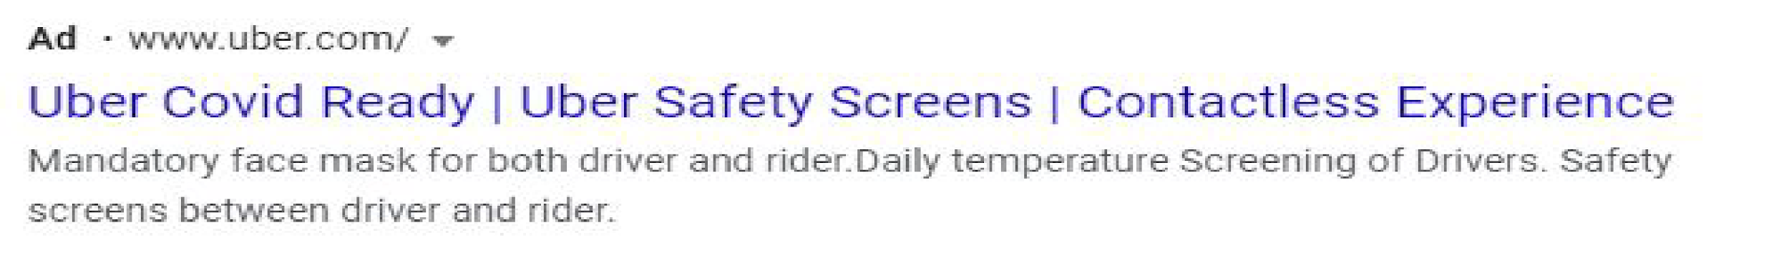
Negative Keyword
Shuttle Ride, Amusement Ride
ADTEXT
Headlines – Uber Covid Ready, Contactless Experience, Ride with Precaution, Safe Covid travel
Description - Safety screens between driver and rider, Mandatory face mask for both driver and rider, Daily temperature Screening of Drivers, Strict adherence of Covid-19 protocols.
Call out extensions
Discount coupons for availing Uber ride, Customer Testimonials on Covid precautions, 50% off for first time customers, referral benefits
Notes:
This template was inserted from Power-user, the productivity add-in for PowerPoint, Excel and Word.
Install Power-user to access thousands of templates, icons, maps, diagrams and charts with Power-user.
Visit https://www.powerusersoftwares.com/
©Power-user SAS, terms of license: https://www.powerusersoftwares.com/terms

Slide 18
Video Ads Strategy
Bidding Strategy
Maximize Conversions
Ad Format
Skippable In-Stream Videos
Objective
Drive Conversions
Networks
YouTube Search Results, YouTube Videos, Video Partners on the Display Network
Locations: Tier 1 and Tier 2 Cities where Uber is present in India
Weekdays – 8am to 12 noon and 4pm to 8pm
Weekends - 11am to 4pm and 6pm to 12am
Targeting people before office hours start and end hours; in the evening before nightlife plans; weekend before brunch, lunch, coffee and dinner hours
Schedule
YouTube Channels & Videos: Youth Content Creators, Music, Events
Websites: City Blogs, Ticket Booking, Entertainment
Apps: Games, Entertainment, Food & Drink, Music, Sports, Ticket Booking
Coupons Availed, Increase in Number of Rides, Referrals, Conversion Rate, Cost per Conversion
Placements
Measurement KPIs

Slide 19
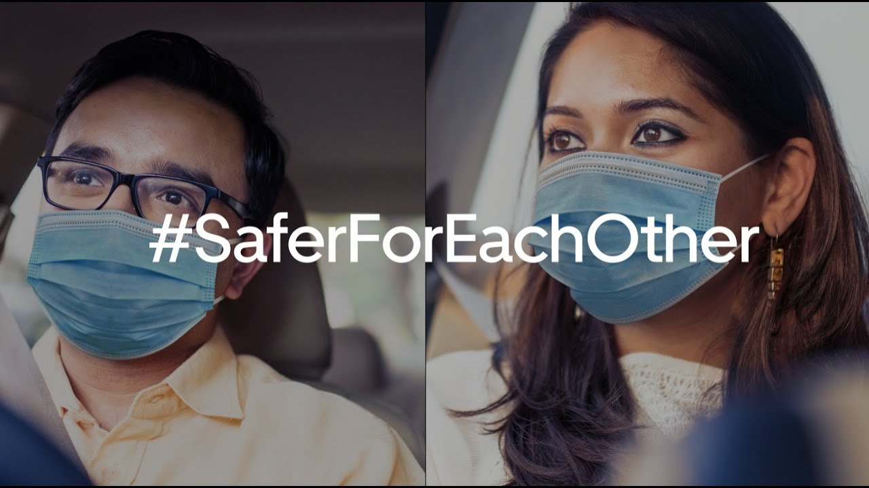

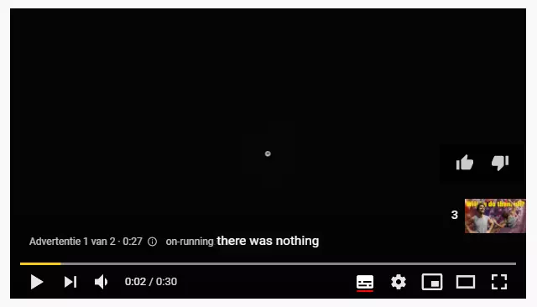
Video Ads Strategy
Ride with Safety, Safety Screens, Safer journeys, Uber rider safety, Ride with Precaution, Ride Safely, Safety, Safe Ride, Uber Protocols, Uber Covid Protocols, Cab Rentals, Taxi Rentals, Sanitised Cab, Sanitised Taxi, Safe Cabs, Safe Taxi, Uber Safety, Uber Covid Ready, Uber India
Events and Listings; Restaurants; Car Rentals; Carpooling; Taxi & Ride Hail Services; Urban Transit
Keywords
Topics
Age → 18-34
Youth and Working Professionals
Income Ranging Top 11% to 50%,
Audience
Demographics
Technology – Mobile Enthusiasts, Social Media Enthusiasts
Vehicle & Transportation – Taxi Service Users
Travel – Business Travelers
Lifestyle & Hobbies – Business Professionals, Frequently attends live events, Nightlife Enthusiasts, Outdoor Enthusiasts
Food & Dining - Frequently dines out
Beauty & Wellness – Frequently Visits Salons
Travel – Car Rental
Real Estate – Moving & Relocation
Event Tickets, Employment, Dating Services
Moving – Moving Soon, recently moved
Affinity Audience (What are their interests and habits)
In Market and Life Events Audience
Previous record of frequent rides with Uber, Viewed any video from Uber channel, Users who visited the website and the app in the past 7 days, Users took an action on the app
Remarketing & Similar Audience

Slide 20

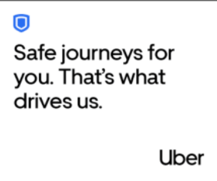
Mobile Advertising Strategy
Objective: Increase the recency and frequency of rides through the app
Metrics: Number of clicks, Conversion rate, Return on Ads Spent
Push Notification
Retargeting Ads
Incomplete transaction reminder
Personalized notification every morning and evening
Personalized travel notifications for the weekend
Moment Marketing
In-app Banners and Overlay Ads on apps such as TOI, Spotify, ET Prime, Inshorts
Hey Raj! Planning on going to Dadar?
Travel Safely with Uber
Use Code COVID100 for ₹100 off
Anxious over getting the new variant?
Uber drivers have face cover checks and all healthy & safety materials. Book your Uber

Slide 21
DISPLAY ADS STRATEGY
Affinity -
Habits/Interests - Frequent intra-city travel for professional and social purposes
Demographics - Aged 18-35, both males and females, Annual income 6 lakhs and above
Life events - Recently moved to a new city
In-market - Looking for safer mobility options within budget
Remarketing and customer match - Previous record of frequent rides with Uber
Custom Audience (based on above interests)
Keywords - “covid travel restrictions”, “curfew timings”, “safety precautions covid” , “uber safety protocols”, “ride safely”
URLs - Blogs/articles on covid safety precautions, third wave predictions, vaccination status of the country, food services (suggesting restaurants), travel sites and blogs/articles
App categories - Food and restaurants, movies, travel

Slide 22
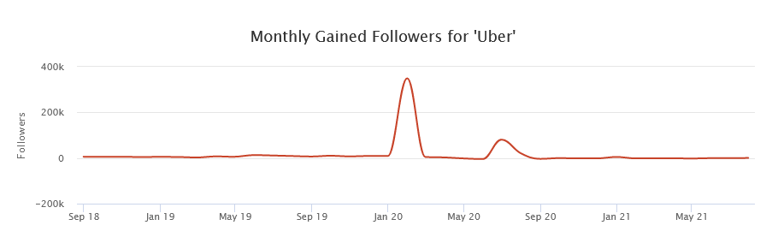
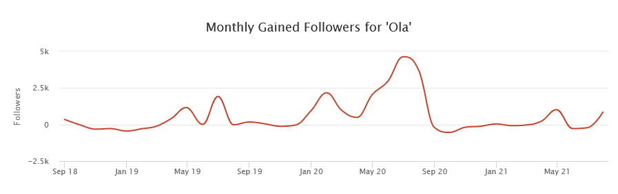


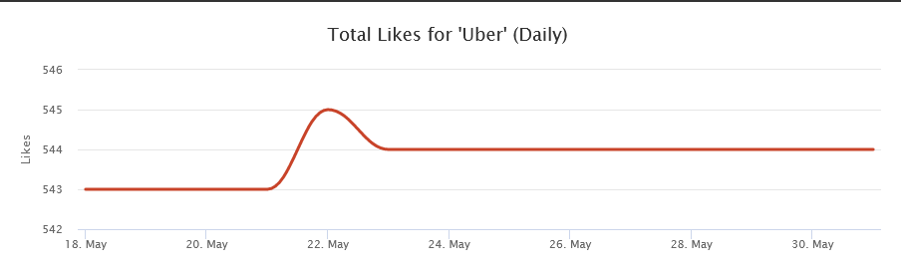
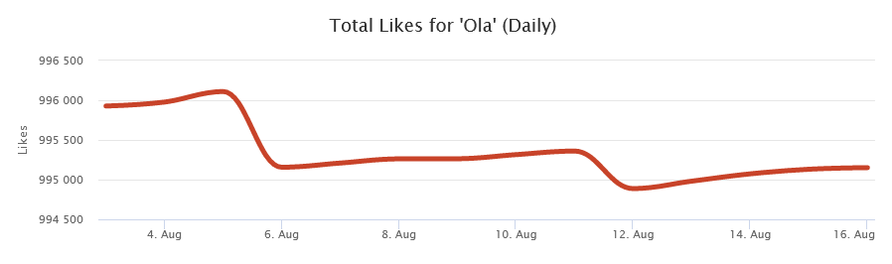

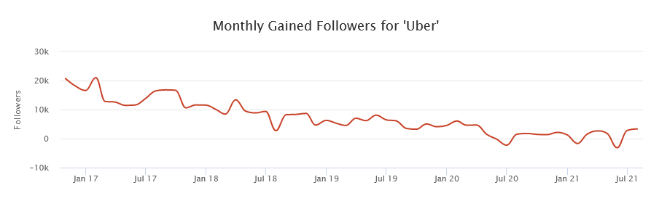
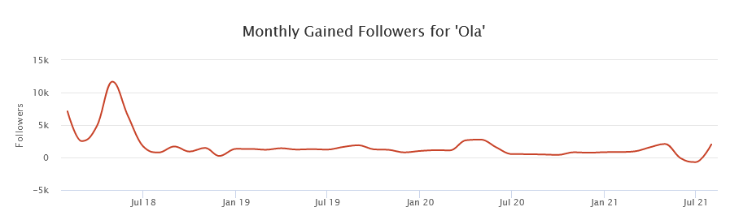
SOCIAL MEDIA ANALYTICS
UBER
OLA
Have a great potential on Twitter, as compared to Ola. Can leverage the platform.
On Instagram, the followers gained are constant over a period of time, unless when a campaign is launched.
Able to perform better than Ola on Facebook, but engagement is constant.

Slide 23
SOCIAL MEDIA STRATEGY
OBJECTIVE
AUDIENCE PROFILE
SEGMENTATION
Action to drive more rides
WHO
WHAT
WHERE
WHEN
HOW
Based in interest, like the pages they follow, what ads they interact with.
Demographics= Family+working.
Behaviour based on the activity they do on Instagram and facebook (posts, reels, stories)
Young professionals
Age: 15-30
Hygiene and Hub content
Hero content in the form of stories, connecting to the people’s emotions.
Informative content regarding the safety protocols followed.
Incentives and offers
Uber have a high engagement in Twitter, so leverage this.
Instagram: To gain more followers.
Facebook: to increase engagement
Post twice during weekdays and twice during weekends
Morning and evening.
Static posts.
Videos showing the safety protocols.
Tweets.
Replying to customers.
Increase in the number of rides through the app
Increase engagement on the website and the app.
TYPE OF MEDIA USED
Paid media : Ads on Facebook and Instagram
Owned Media
User Generated Content

Slide 24
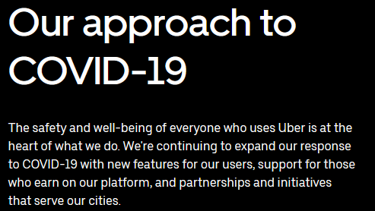
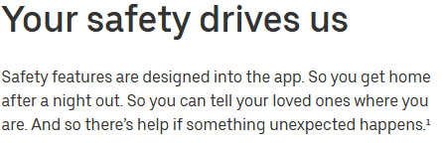
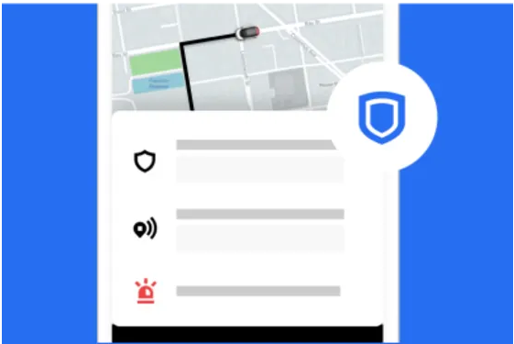
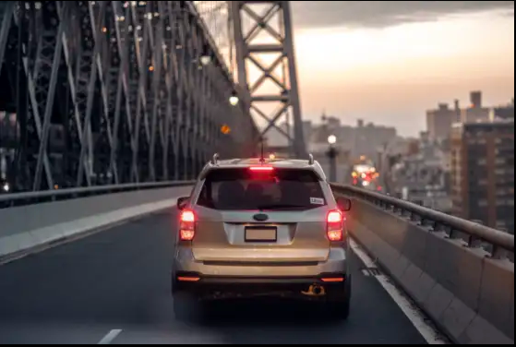

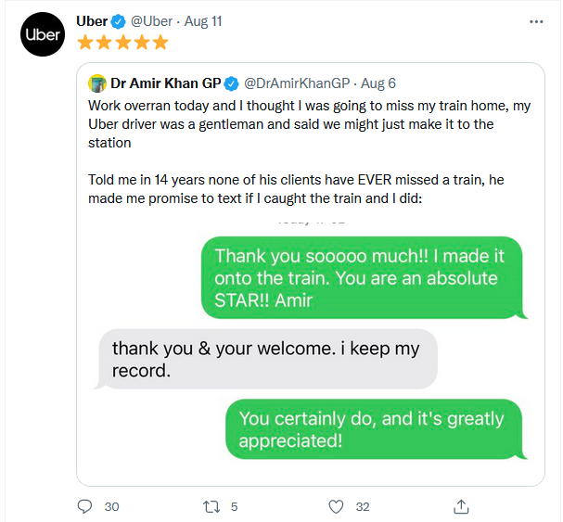
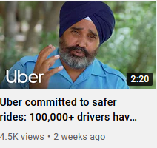
Objective – Consideration +Action
Facebook Content
Facebook – Content regarding the safety protocols followed, how Uber is helping to restrict covid
Instagram Content
Instagram: Content which is visually pleasing. Hero content that tells stories of how drivers played their part during covid crisis.
Twitter: Uber can try to convert its page to give it a persona, post general statements, opinions regarding Covid and reshare other user’s content
Twitter Content
Youtube Content
Youtube: Show stories and interviews of how covid affected its drivers and how uber helped them to continue their journey.
Measurement Metrics
Impression of the campaign
Likes, Shares, retweets and comments of the campaign
Active number of followers increase after the campaign.

Slide 25
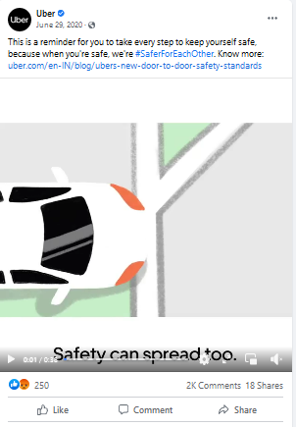
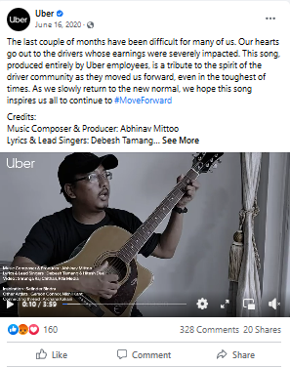
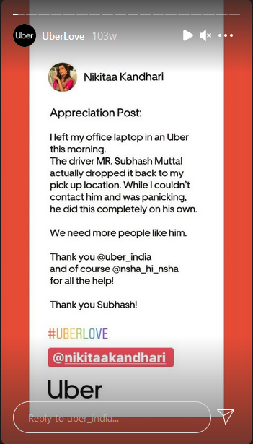
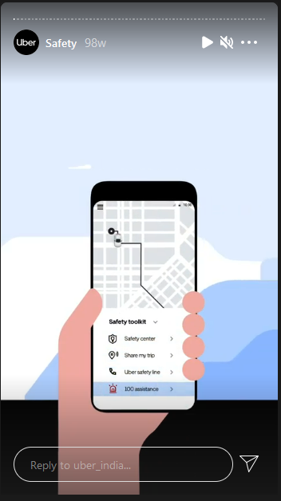
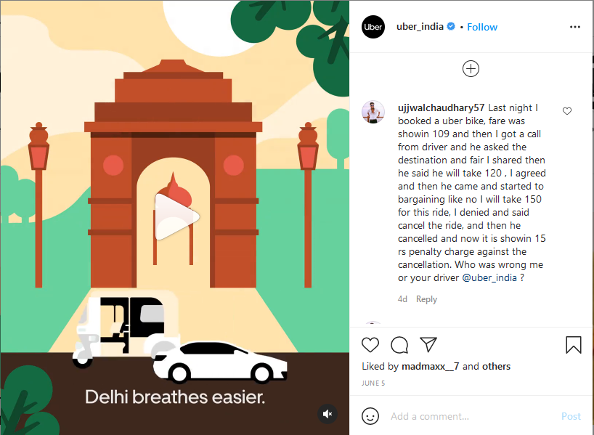
Ad’s Objective – Consideration + Action
Carousel Ads: We want our customers to know what Uber is doing for Covid safety at every step of the journey and how is it helping its employees as well.
Video Ads: Video ads in the form of posts, reels depicting stories of how Uber drivers had maintained covid safety protocols everyday. Miniature versions of these ads can be shown on Youtube.
Story Ads: We want to leverage story ads to connect and engage with the users, leading them to website for reviews or to the app for booking rides. We would be having user generated content on stories.
Promoted Trend: A promoted trend show up as one of the first tab under “Trends for you”, both in explore tab and the timeline.
Measurement Metrics
Impression of the campaign
Lead generation for Social media posts
Ad relevancy scores on Facebook
CTR of the Ads run
Coupons redeemed through the post clicks
AD TIMINGS
Tues - Wed: 9-10 am & 5-6 pm
Rest of weekdays : 11-1 pm

Slide 26
Mobile Advertising Strategy
Objective: Increase the recency and frequency of rides through the app
Metrics: Number of clicks, Conversion rate, Return on Ads Spent
Push Notification
Retargeting Ads
Incomplete transaction reminder
Personalized notification every morning and evening
Personalized travel notifications for the weekend
Moment Marketing
In-app Banners and Overlay Ads on apps such as TOI, Spotify, ET Prime, Inshorts
Hey Raj! Planning on going to Dadar?
Travel Safely with Uber
Use Code COVID100 for ₹100 off
Anxious over getting the new variant?
Uber drivers have face cover checks and all healthy & safety materials. Book your Uber

Slide 27
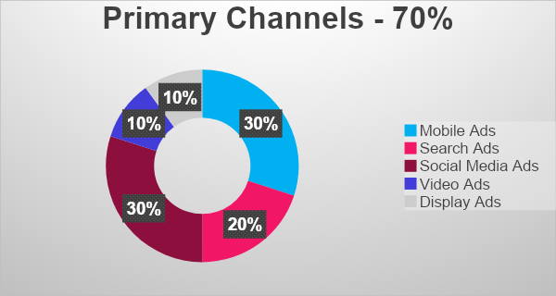
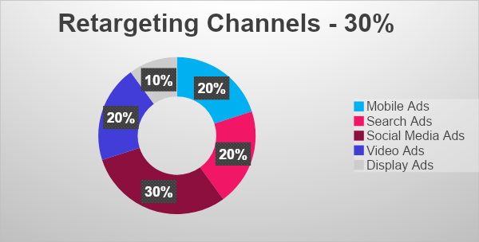
Budgeting
Majority of the budget is dedicated to search and mobile ads since the customers have the app installed and are looking to book a ride
The warm leads will result in a lower Cost per Acquisition
Social Media ads are another prime area of focus as they allow us to reach a highly targeted audience
Video and display ads have higher CPAs than the other types of ads
Substantial chunk of our budget is dedicated to retargeting due to the nature of our product, which requires repeat interactions for conversions
For retargeted ads, Cost per Conversion is much lower since the customer has already shown interest in our service by downloading the app.
Retargeting to be done to create a multi touchpoint ecosystem to drive repeat sales
Touchpoints will serve as reminders to nudge the audience towards conversion
This budget is subject to change as we will continuously test the performance of different ad types and continue to optimize them. We will divert the budget from low performing ad types towards high performing ones to get maximum conversions

Slide 28
CAMPAIGN BUDGET = ₹50,00,000
Primary Channels | Percentage Split | Value | Retargeting Channels | Percentage Split | Value
 | 70% | 35,00,000 |  | 30% | 15,00,000
Mobile Ads | 30% | 10,50,000 | Social Media Ads | 30% | 4,50,000
Search Ads | 20% | 7,00,000 | Display Ads | 10% | 1,50,000
Social Media Ads | 30% | 10,50,000 | Mobile Ads | 20% | 3,00,000
Video Ads | 10% | 3,50,000 | Video Ads | 20% | 3,00,000
Display Ads | 10% | 3,50,000 | Search Ads | 20% | 3,00,000
Max
Max CPA = Rs. 4000
Max CPC = Rs. 140
Min ROAS = 4x
Target
Ideal CPA = Rs. 3000
Ideal CPC = Rs. 100
Ideal ROAS = 5.5x

Slide 29
THANK YOU

